Slide 1
Unit Two: Social Movements Through Indigenous Music
Teresa Cisneros with Angie Morrill

Slide 2
Definitions of Terms
Assimilation: The often involuntary process by which an underrepresented group’s language, culture, and lifeways resemble those of a dominant group
Cultural Suppression: Social, historical, and legal methods to limit or prohibit the language, lifeways, and beliefs of a non-dominant group
Activism: Direct action to bring about political or social change
Decolonization: Critical examination and resistance to colonial ideologies and empowering Indigenous ways of knowing
Protest Movement: Collective effort or efforts on many fronts to achieve social and political justice from dominant mainstream culture
Ceremonial Music: Songs and rhythms for sacred tribal rituals and gatherings
Storytelling: Traditional Indigenous method of teaching, preserving history, and sharing wisdom
Resistance: Acts of opposition against systemic oppression, often in defense of identity, culture, and rights

Slide 3
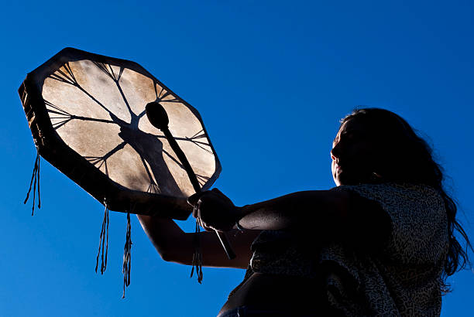
Indian Education 101
The Role of Music in Indigenous Life
Music is integral to Native identity. It is deeply spiritual, relational, and often inseparable from storytelling, ceremony, and intergenerational teachings. Its suppression was a targeted colonial tool to dismantle cultural memory and self-determination.

Slide 4
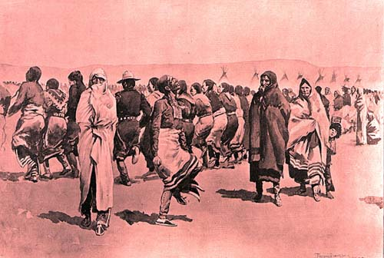
History of Musical Suppression
From boarding schools to federal bans on sacred songs and ceremonies, Indigenous peoples experienced centuries of silencing. Many traditions survived through secrecy, resilience, and acts of resistance.

Slide 5
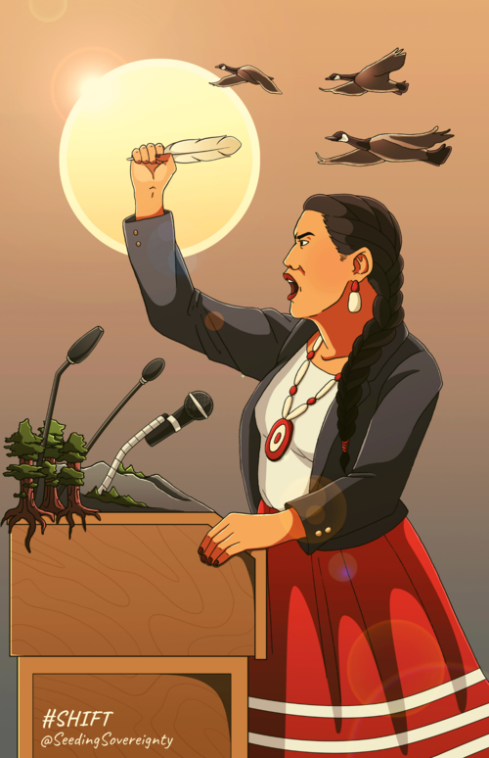
Contemporary Movements
Movements such as #NoDAPL, Land Back, and the Missing and Murdered Indigenous Women & Girls (MMIWG) efforts have used music as a central organizing and cultural healing tool. Artists like Taboo (Shoshone/Mexican), Supaman (Apsáalooke), and Lyla June (Diné/Tsétsêhéstâhese) bridge ancestral sounds with modern advocacy.

Slide 6
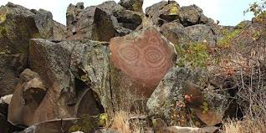
Cultural Accuracy & Competence: Why it Matters
Misrepresenting Indigenous cultures contributes to ongoing harm. Students should understand that Native communities are living, diverse, and sovereign nations—not relics of the past.

Slide 7
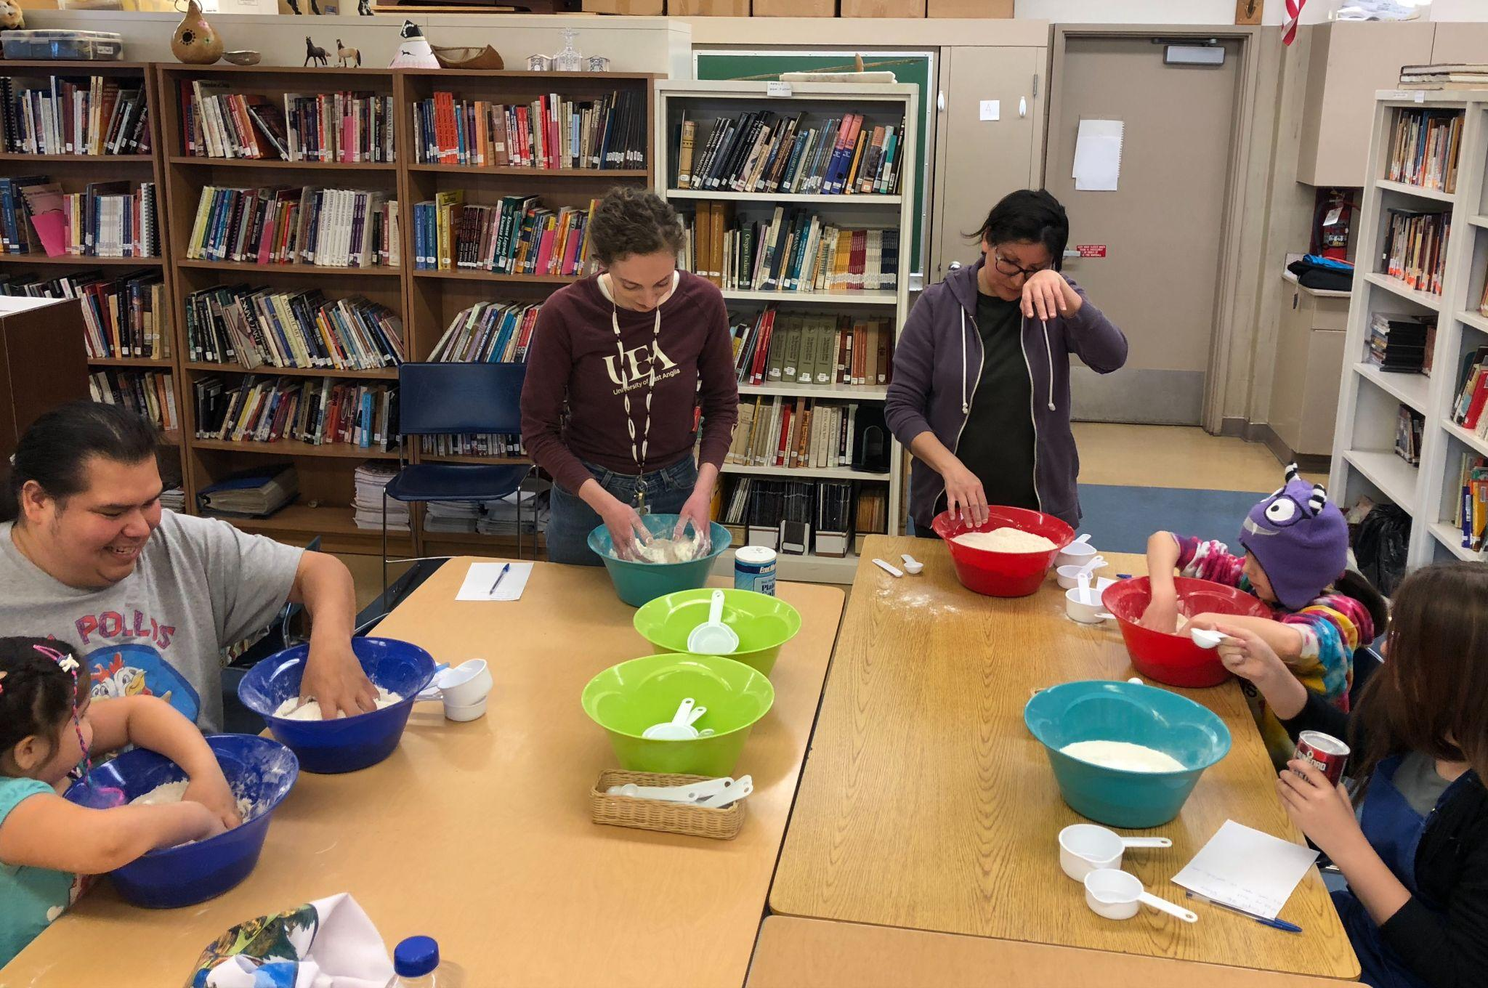
Reflection and Discussion
What is available for Indigenous students in your schools? Do they have cultural programs available to them? Does your school observe Indigenous People’s Month? How is it observed? Share with the people at your table.
Sovereignty is essential to understanding why Native Americans enrolled in federally recognized tribes have government to government relationships with the federal government, the states, and other organizations. Tribal History/Shared History on the Oregon Department of Education website has an essential understanding document as a resource you can use.

Slide 8
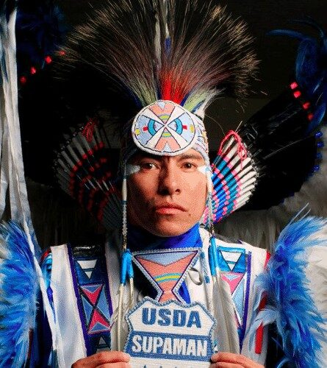
What are Best Practices for Culturally Accurate Teaching?
Use primary sources, Native-created content, and songs by Indigenous artists.
Avoid pan-Indigenous generalizations. Be specific about tribes, languages, and geography.
Acknowledge ongoing colonial structures and sovereignty issues.
Practice relationality: encourage listening, empathy, and responsibility in learning.

Slide 9
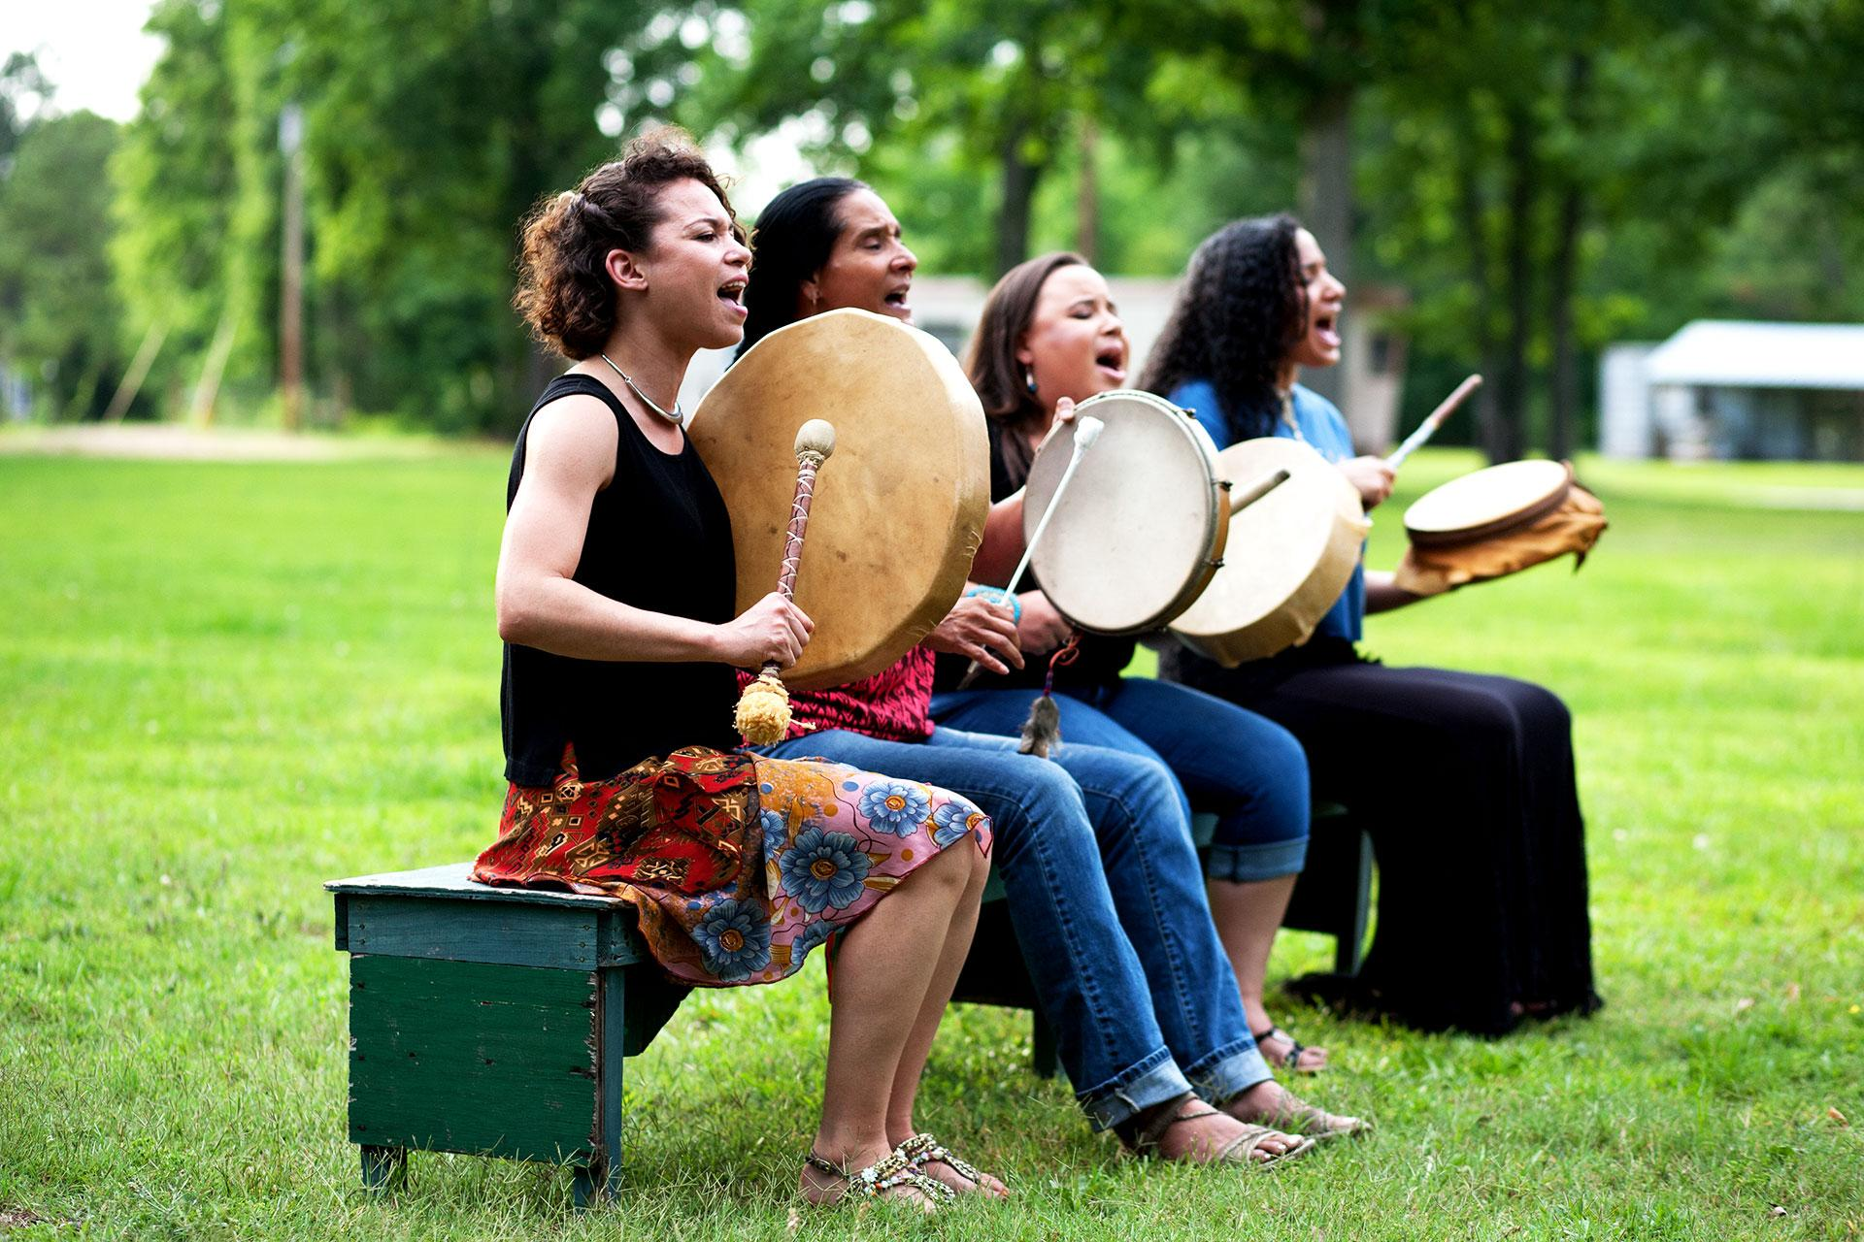
For Example:
In Lesson 2, students engage with formerly banned musical traditions—this introduces them to cultural suppression while also emphasizing Indigenous survival. Lessons 3 & 4 bridge historical and modern protest movements to help students understand continuity and resilience. We teach towards the future while acknowledging the past.

Slide 10
Reflection and discussion
From Billie Holiday singing “Strange Fruit” to Woody Guthrie singing “This Land is Your Land” from Janelle Monae singing “Say Her Name” to Pete Seeger’s “We Shall Overcome” and “Green Day’s “American Idiot” - artists have often included political messages in their music.
What are your experiences with protest music?
What impact has protest music had on social movements?
Are there songs your students could bring to class that represent social movements they care about?
Can listening to Indigenous music give students more understanding towards Indigenous issues that they also care about? Climate justice for example?

