Slide 1
Unit Three
Social Movements Through Indigenous Music:
The Storyteller
Teresa Cisneros with Angie Morrill

Slide 2
Definitions of Terms
Sovereignty: The inherent right of Indigenous nations to govern themselves.
Assimilation: The often involuntary process by which an underrepresented group’s language, culture, and lifeways resemble those of a dominant group
Boarding Schools: Institutions aimed at assimilating Native youth by removing cultural identity and separating students from families
Cultural Suppression: Social, historical, and legal methods to limit or prohibit Native music, language, lifeways, and beliefs
Activism: Direct action to bring about political or social change
Protest Music: Songs expressing resistance and raising awareness of injustice
Revitalization: Restoration of suppressed cultural practices

Slide 3
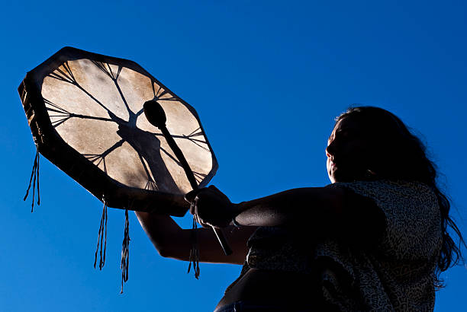
Indian Education 101
This Unit Explores:
Historical and ongoing suppression of Native culture, particularly music (e.g., Religious Crimes Code of 1883).
The use of music in boarding schools and its evolution into a form of resistance.
Sovereignty of tribal nations and the importance of cultural expression.
Resilience through music during movements such as AIM (American Indian Movement), 1969 Tribes of All Nations Occupation of Alcatraz Island and the resistance at Standing Rock #NoDAPL

Slide 4
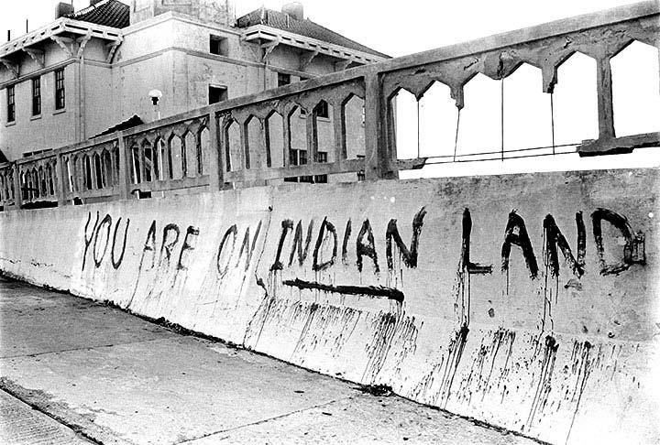
Tribal History/Shared History Essential Understandings
Connections:
Essential Understandings 1: Indigenous peoples have lived in Oregon since time immemorial.
Essential Understandings 8 & 9: Treaties, federal policy, and genocide disrupted but did not erase Indigenous presence.
Essential Understandings 10: Indigenous efforts toward revitalization and reclamation are active and ongoing.

Slide 5
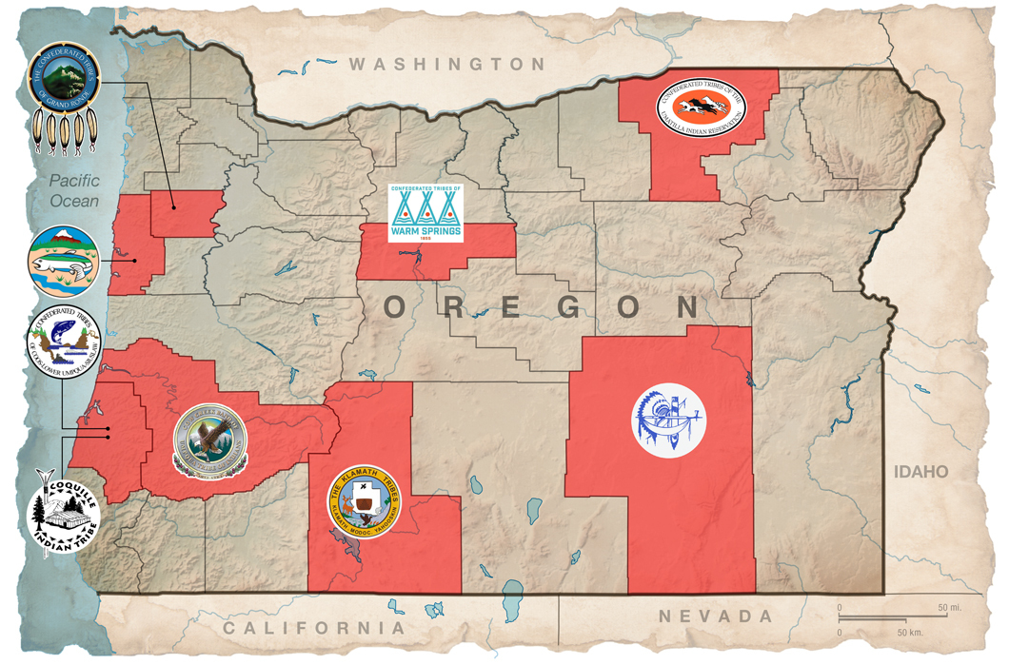
Implementing DEI Competency & Relevancy
Use culturally relevant music to connect Indigenous histories with present-day social justice.
Explore how music reinforces identity and fosters resilience.
Utilize Oregon Department of Education’s Tribal Consultation Toolkit for respectful engagement with tribes.

Slide 6
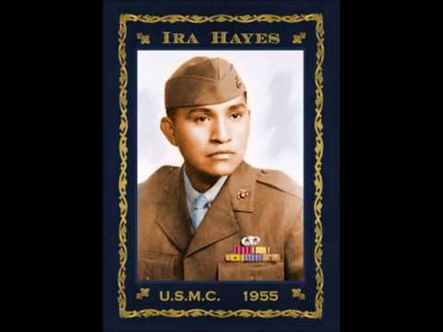
Lesson 1: Music and Protest
Introduce social protest and how music spreads awareness of social issues
Listening: Indigenous protest songs (e.g., “Ballad of Ira Hayes,” “Look at Us”)

Slide 7
Activity
Students write protest lyrics about immediate issues. Suggest the students change the words to a popular song. If they are willing to share their lyrics, let the students give positive feedback.
Exit Ticket: Reflect on the impact of banned music. Do students believe it makes a difference to social issues? Have they learned things they wouldn’t have known because of protest music?

Slide 8
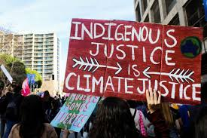
Reflection and Discussion
What issues concern your students? Are they passionate about climate justice, gender equality or something else? What is their preferred way to share their concerns?

Slide 9
Lesson 2: Suppression of Native Music
Examine musical suppression in boarding schools. Banning Indigenous language and music and replacing that with English language and Christian music was intended to “kill the Indian” and assimilate Indigenous people.
“During the year the students have received class instructions in vocal music. They are learning to sing by note and are drilled regularly in chorus-singing. The singing exercises are a great profit, and our hymns[4] and choruses seem now to afford more pleasure than did formerly the meaningless monotones and minor wails of their savage life. (United States Office of the Commissioner of Indian Affairs 1881, 185)”
U.S. Office of the Commissioner of Indian Affairs. 1881. Annual report of the Commissioner of Indian Affairs. https://perma.cc/J7BP-MPHS

Slide 10
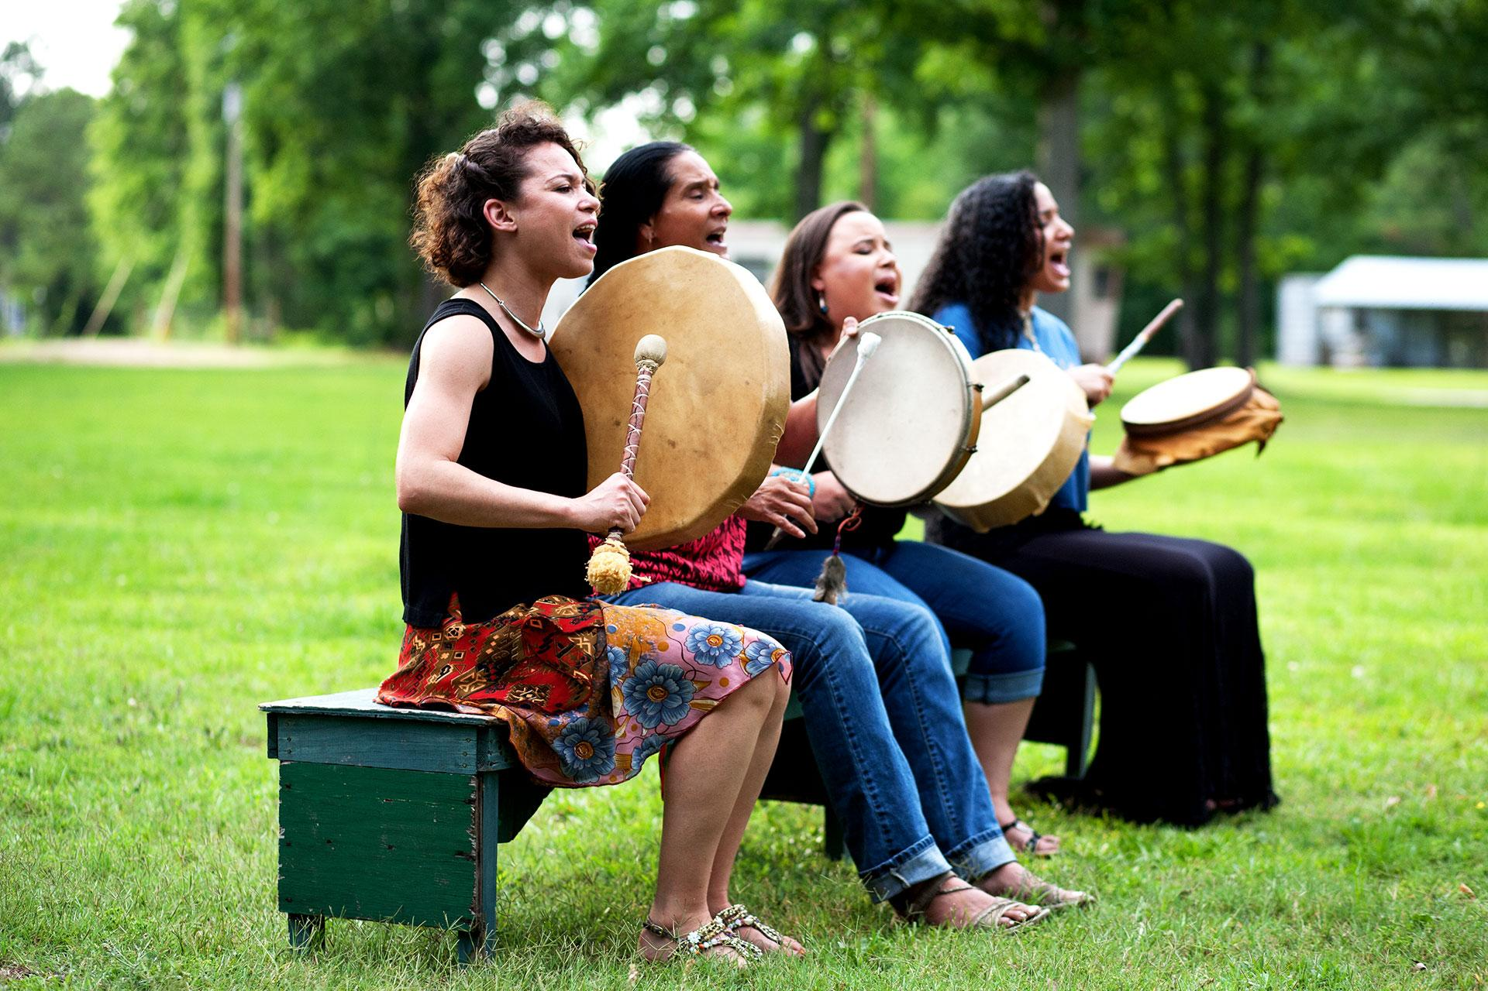
Listen and Activity
Listening: Big Drum, Hand Drum, Throat Singing, Bird Singing. Different tribes in different geographic areas have different ways of making music and sharing culture.
Four Corners Activity: Choose an act of resistance to suppression and students can argue for their choices.

Slide 11
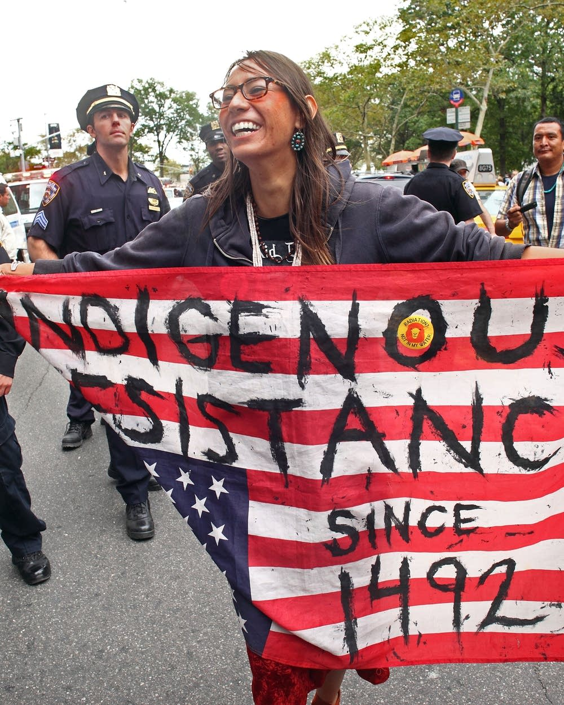
Lesson 3: 1960’s and 1970’s Protest Movement
Have student groups research American Indian Movement (AIM), Alcatraz Occupation, Wounded Knee, etc.
Use Thinking Organizer #1 to track movement goals and associated music.
Share out song analysis related to each movement

Slide 12
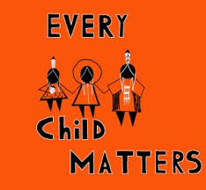
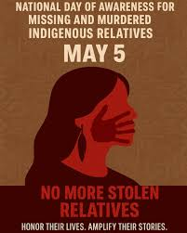
Lesson 4: Recent Indigenous Activism
Have students do individual research on current or recent movements
Use Thinking Organizer #2 to analyze protest songs
Focus on movements like #NoDAPL, MMIWG2S and Every Child Matters

Slide 13
Lesson 5: Final Assessment
Lesson 5: Final Assessment
Part 1: Paragraphs answering essential questions on protest music and cultural suppression.
Part 2: Analyze Lila June’s “Water is Life” or write original protest lyrics.

Slide 14
Reflection and discussion
From Billie Holiday singing “Strange Fruit” to Woody Guthrie singing “This Land is Your Land” from Janelle Monae singing “Say Her Name” to Pete Seeger’s “We Shall Overcome” and “Green Day’s “American Idiot” - artists have often included political messages in their music.
What are your experiences with protest music?
What impact has protest music had on social movements?
Are there songs your students could bring to class that represent social movements they care about?
Can listening to Indigenous music give students more understanding towards Indigenous issues that they also care about? Climate justice for example?

