Slide 1
Unit One:
Exploration of Native American Music
Teresa Cisneros with Angie Morrill

Slide 2
Opening Activity
Introduce yourself and share what music you are listening to and enjoying right now?
How do you think musician’s backgrounds influence the music they create?
What do you like about this music?
Does the music you like fit into a genre?
Do you have any experience or knowledge of Native American music or musicians?
We will explore some of the concepts and genres in the following slides.

Slide 3
Lesson Overview
This unit provides foundational knowledge of Native American musicians and their influences on musical genres
Students will learn that while Indigenous people have been here since Time Immemorial they are also part of and contributing to modern communities
This unit will prepare students to think about music and cultural influences and broaden their awareness of Native American music and genres

Slide 4
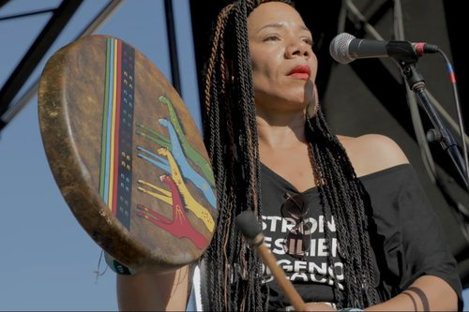
Definition of Music Concepts
Contemporary Music
Definition: Music that is performed and created using current rhythms, harmonies, and lyrical themes.
Context: In Indigenous music, contemporary music can blend traditional sounds and storytelling with modern instruments, genres, and production techniques, helping connect Indigenous identities and cultural narratives with today’s audiences.
Notes:
Martha Redbone singing “Drums” at the 2018 Smithsonian Folklife Festival. Credit: Roadwork Center.

Slide 5
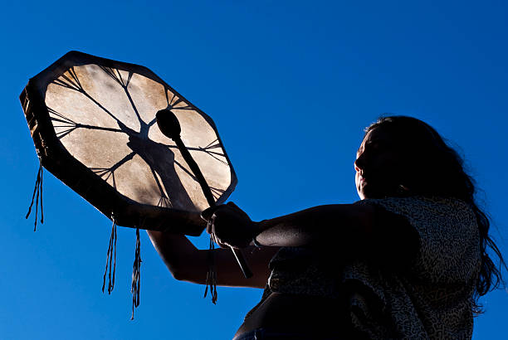
Genres
Definition: Categories of music, literature, or art that develop over time within a culture, subject to change based on cultural and societal influences.
Context: Indigenous music genres can include traditional, ceremonial, contemporary Indigenous pop, and Indigenous jazz. Indigenous musicians often blend multiple genres to honor their cultural heritage while expressing modern Indigenous experiences.

Slide 6
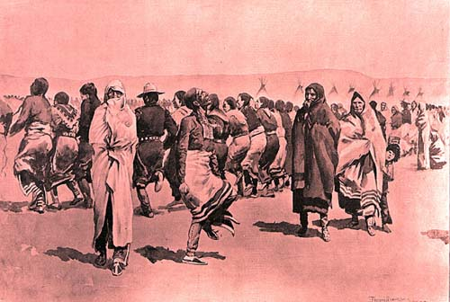
Electronic Powwow Sample in a Song
Definition: Incorporating traditional powwow drumming, chants, or other Native sounds as electronic samples within modern music productions.
Context: This technique reflects a fusion of traditional Indigenous music with electronic genres like EDM or hip-hop, often used by Indigenous artists to bring ceremonial rhythms into contemporary spaces, making cultural expressions accessible to younger audiences.

Slide 7
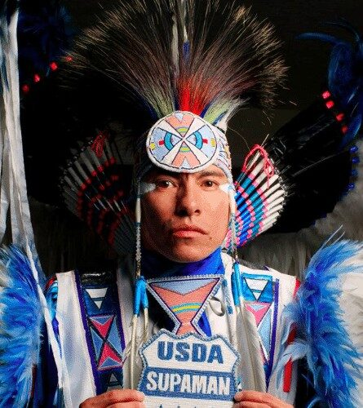
Listening Activity
The curriculum includes three songs to listen to and a worksheet. We can do this activity together and share our answers to the questions

Slide 8

Reflection and Discussion
What did the music have in common beyond the musicians being Native? How did each song make you feel? How do you think your students will respond?

Slide 9
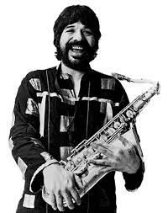
Jim Pepper
The second part of the unit goes into detail about Jim Pepper as a musician. Talk about the influence he had on other musicians and his ongoing legacy. Then introduce the students to the online archive of musicians and the assignment to present their research on one of the musicians, just as you did about Jim Pepper.

Slide 10
Presentations
The students will present their research singly, in groups or grouped by genre.
What questions do you have that they might share?

