Slide 1
Unit Four
Digital Native American Music Festival
Teresa Cisneros with Angie Morrill

Slide 2
Definitions of Terms
Indigenous: Originating from and belonging to a particular place; in this context, Native American/Alaska Native peoples.
Tribal Sovereignty: The right of American Indian tribes to govern themselves within U.S. borders.
Cultural Appropriation: Using elements of a culture not your own, especially without understanding or respect.
Fair Use: Legal doctrine allowing limited use of copyrighted material without permission under certain circumstances.
Narration/MC: Spoken word that introduces and transitions between performances in a digital festival.
Storyboard: A visual plan showing scenes or events in sequence, used to guide digital or film projects.
Production Team: Group roles like editing, curation, narration, marketing involved in creating the festival.

Slide 3
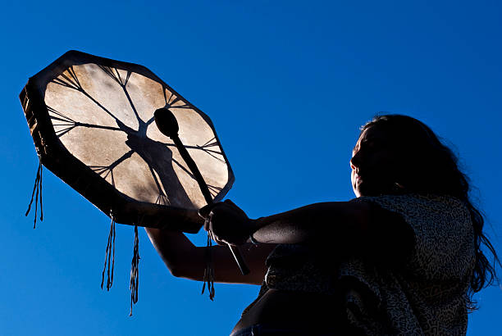
Indian Education 101
This Unit Explores: Native American contributions to music and culture are frequently excluded or misrepresented in mainstream curricula.

Slide 4
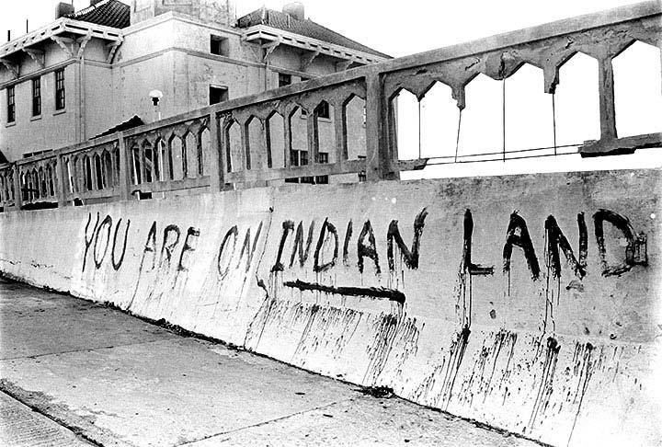
Tribal History/Shared History framework emphasizes:
Tribal sovereignty and governance
Historical and contemporary Tribal presence
Contributions of Tribes to local and national culture
Students are encouraged to recognize Native musicians as contemporary culture-bearers, not relics of the past.
Avoid "damage-centered narratives" and highlight Indigenous joy, resilience, and innovation.

Slide 5
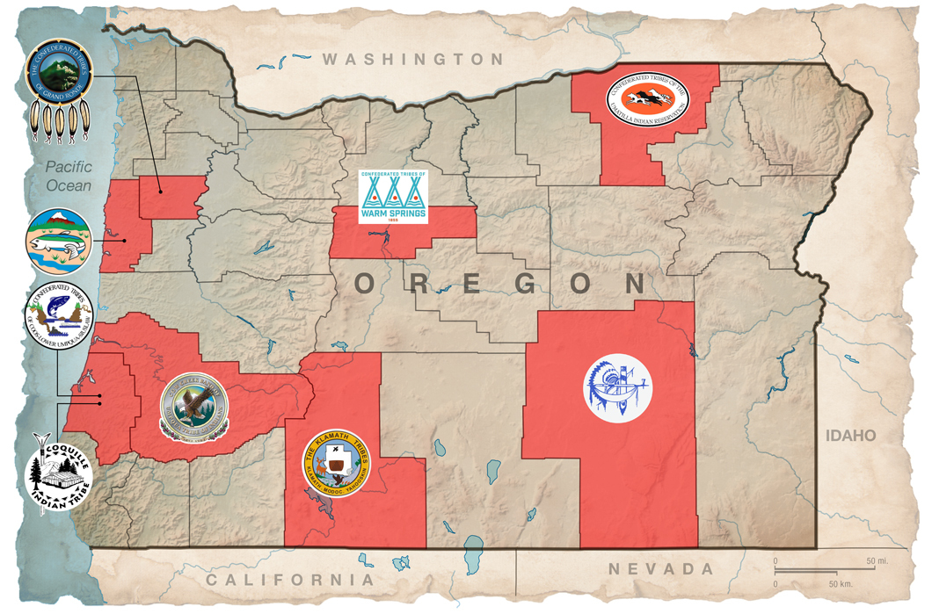
Implementing DEI Competency & Relevancy
Cultural Relevance: Showcase Indigenous musicians across diverse genres (jazz, hip hop, traditional, rock) to avoid monolithic portrayals.
Avoiding Harm: Guide students away from stereotypes or tokenism. Emphasize the importance of tribal affiliation and appropriate attributions.
Representation Matters: Students will explore how Native musicians have historically been excluded from mainstream platforms and how digital media can elevate their voices.
Encourage relational accountability—students should consider their audience, the communities they represent, and the musicians’ perspectives

Slide 6
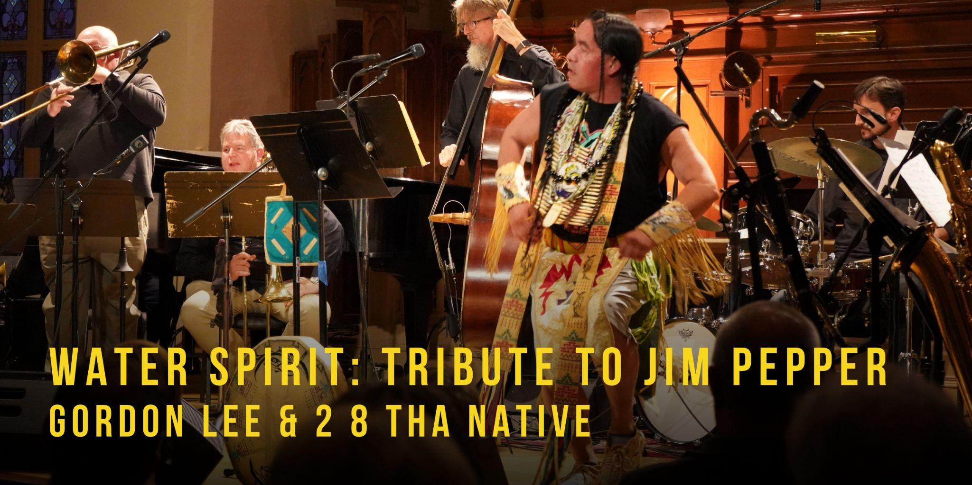
Lesson 1: What is a Festival?
Have students define components of a music/film festival.
Create “production teams” and assign roles.
Develop team posters with duties and responsibilities.

Slide 7
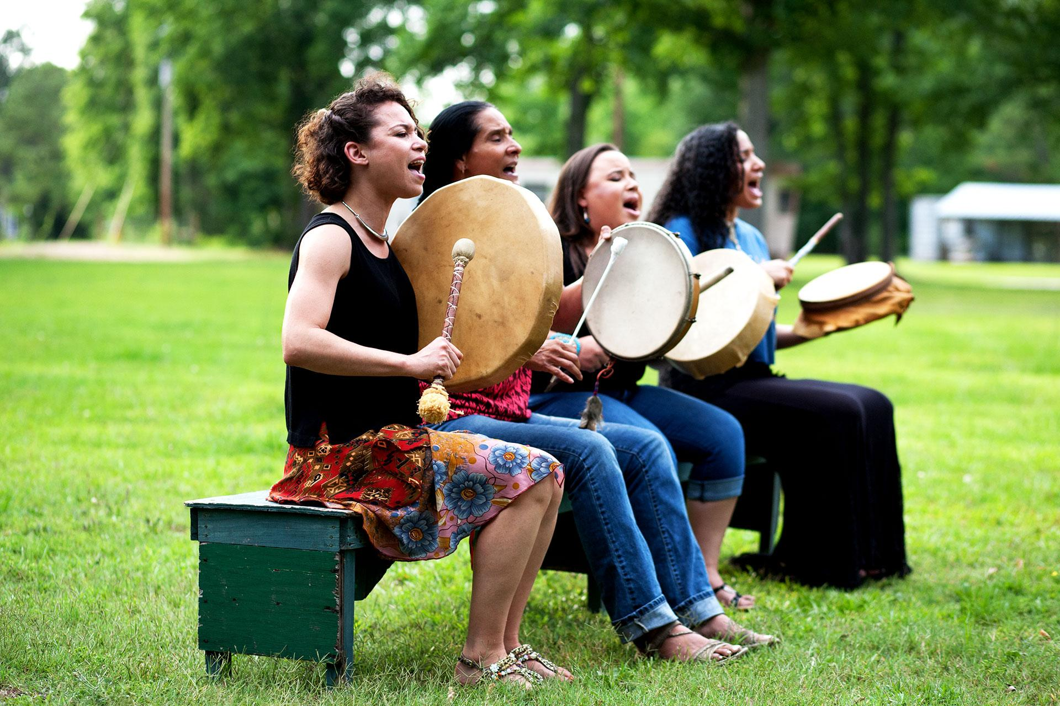
Lesson 2: Research and Planning
Students explore the Speak/Sing Native Database.
Choose a theme (genre, issue, cultural lens).
Draft festival outline: goals, audience, style, responsibilities.

Slide 8

Lesson 3: Storyboarding
Create a visual plan showing order of performances, MC segments, transitions, and closing.
Identify where and how narration will appear.

Slide 9

Lesson 4: Production
Gather footage from the database and follow Fair Use guidelines.
Write MC scripts, record narration, and begin editing.

Slide 10
Lesson 5: Peer Review
Use the Peer Review Guide to exchange feedback with another team.
Make adjustments to timing, theme consistency, editing, etc.

Slide 11

Lesson Six: Final Festival Submission
Upload completed festival for peer and public viewing.
Reflect on the process and the representation of Native voices in media.
What kind of feedback did you receive? What did the students learn? What would they do differently?

Slide 12
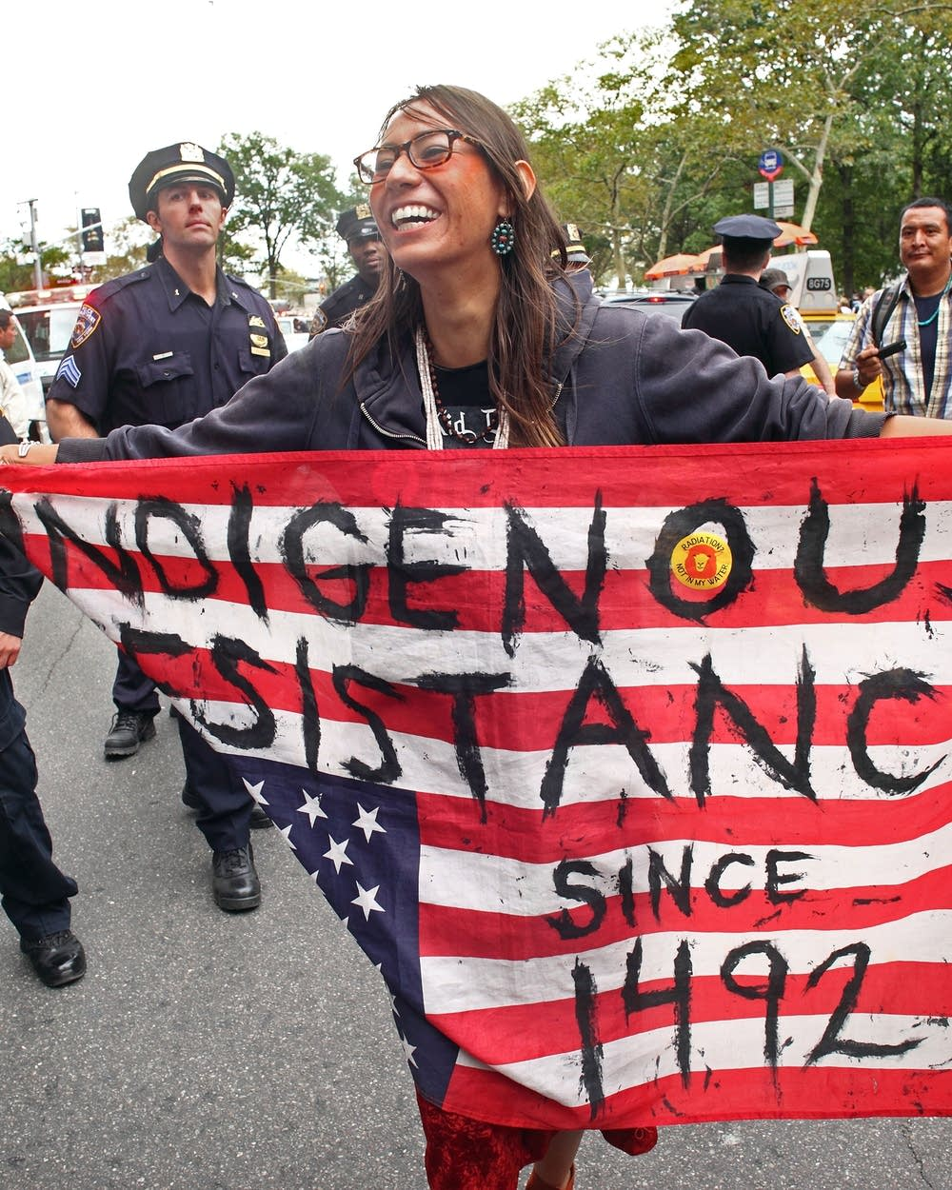
Links to Suggested Resources:
ODE Tribal History/Shared History
Jim Pepper Native Arts Festival
Speak/Sing Native Database
ODE Tribal Consultation Toolkit

Slide 13
Reflection and discussion
From Billie Holiday singing “Strange Fruit” to Woody Guthrie singing “This Land is Your Land” from Janelle Monae singing “Say Her Name” to Pete Seeger’s “We Shall Overcome” and “Green Day’s “American Idiot” - artists have often included political messages in their music.
What are your experiences with protest music?
What impact has protest music had on social movements?
Are there songs your students could bring to class that represent social movements they care about?
Can listening to Indigenous music give students more understanding towards Indigenous issues that they also care about? Climate justice for example?

