Slide 1
Unit Five
Understanding Self Through Creative Expression
Teresa Cisneros with Angie Morrill

Slide 2
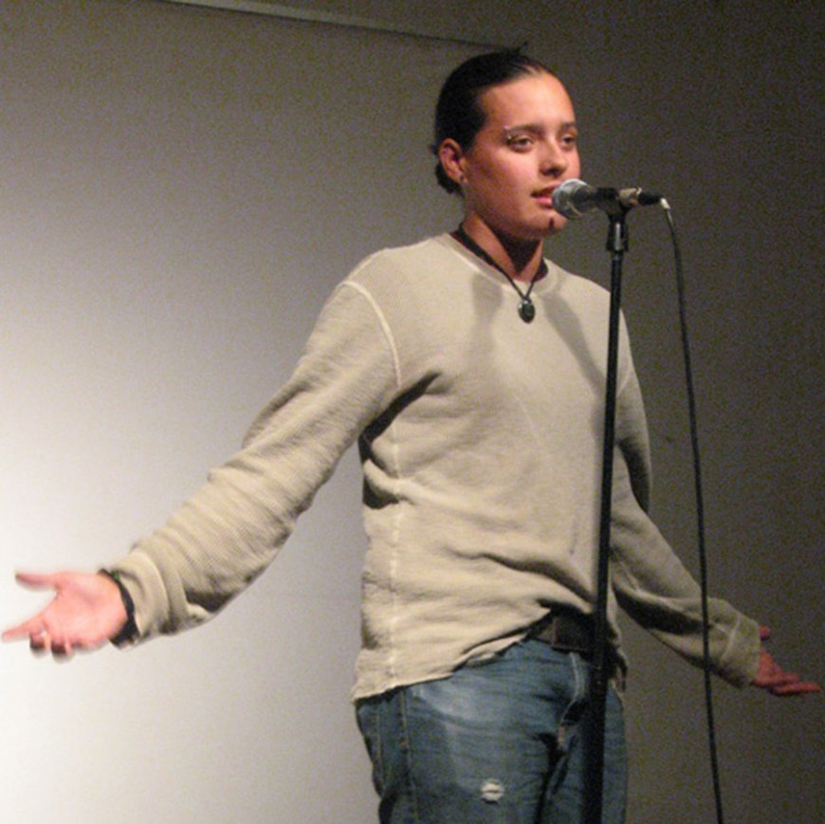
Day One: Introduction to Poetry
Objective: Students will explore the fundamental characteristics of poetry and begin to understand how poetry can express identity.
Materials:
Audio: This Teenage Life
TED-Ed video: What Makes a Poem?
Poetic Devices Handout (provided link)
Student facing handout Teacher facing handout

Slide 3
Day One: Agenda
1. Warm-up: Play This Teenage Life podcast about poetry as a creative outlet.
2. Discussion:
What makes a poem… a poem?
How does a poem differ from other forms of writing?
3. Video Viewing: Watch the TED-Ed video What Makes a Poem?
4. Quick Write: Ask students whether song lyrics, speeches, or tweets can be considered poetry.
5. Exit Ticket: Share responses with peers.

Slide 4
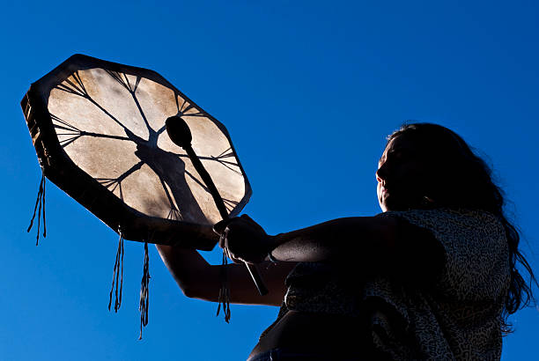
Day Two: Poetic Devices and Annotation
Objective: Students will review poetic devices and practice annotating poems to explore deeper meanings.
Materials:
● Video: Poetic Devices by Testament
https://www.youtube.com/watch?v=FWwFBGOBAQI&t=27s
● Carrying Our Words poem by Ofelia Zepeda (printout)
● Annotation Key and Worksheet (provided in slides)

Slide 5
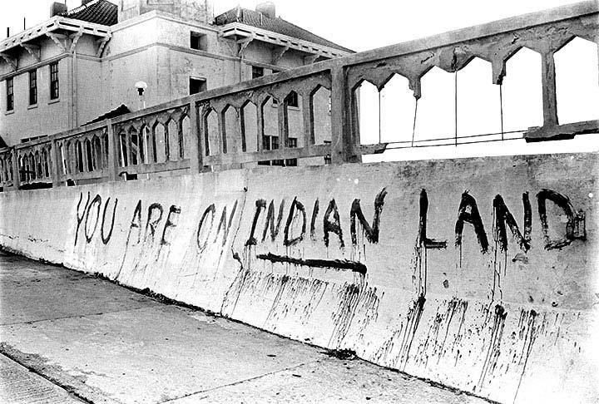
Day Two: Agenda
1. Warm-up: Watch Poetic Devices by Testament.
2. Review: Go over the Poetic Devices handout with examples from the poem. 3. Class Annotation: Work together as a class to annotate Carrying Our Words by Ofelia Zepeda. 4. Group Activity: Students annotate their selected poem from the list using the annotation key. 5. Homework: Complete the graphic organizer based on the annotated poem.

Slide 6
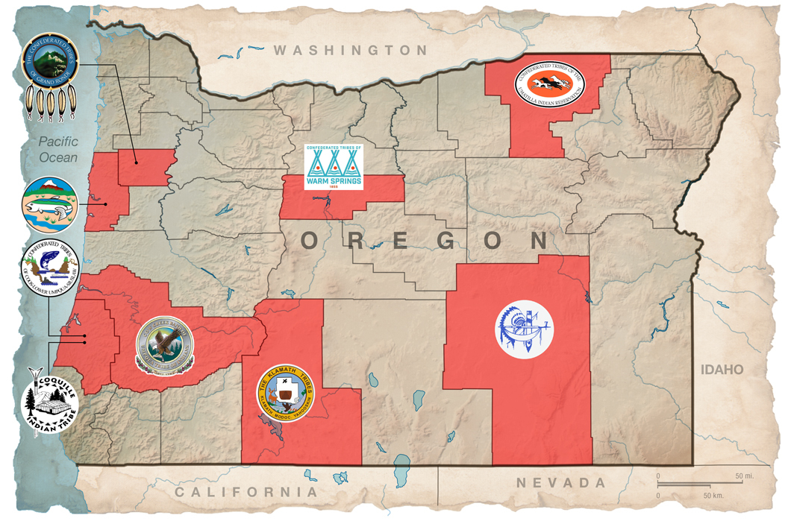
Implementing DEI Competency & Relevancy
Cultural Relevance: Showcase Indigenous musicians across diverse genres (jazz, hip hop, traditional, rock) to avoid monolithic portrayals.
Avoiding Harm: Guide students away from stereotypes or tokenism. Emphasize the importance of tribal affiliation and appropriate attributions.
Representation Matters: Students will explore how Native musicians have historically been excluded from mainstream platforms and how digital media can elevate their voices.
Encourage relational accountability—students should consider their audience, the communities they represent, and the musicians’ perspectives

Slide 7
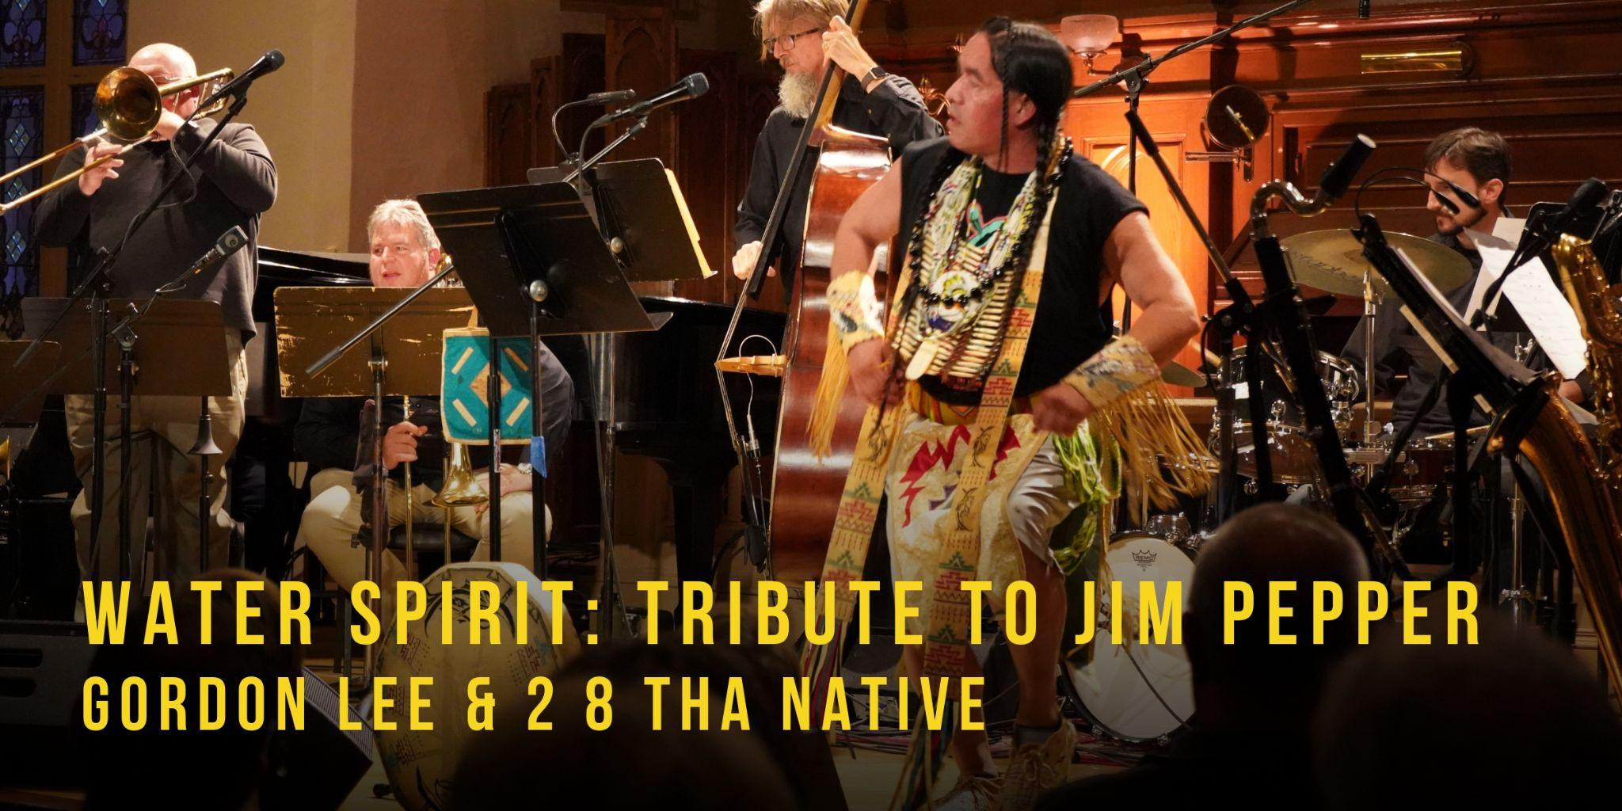
Lesson 1: What is a Festival?
Have students define components of a music/film festival.
Create “production teams” and assign roles.
Develop team posters with duties and responsibilities.

Slide 8
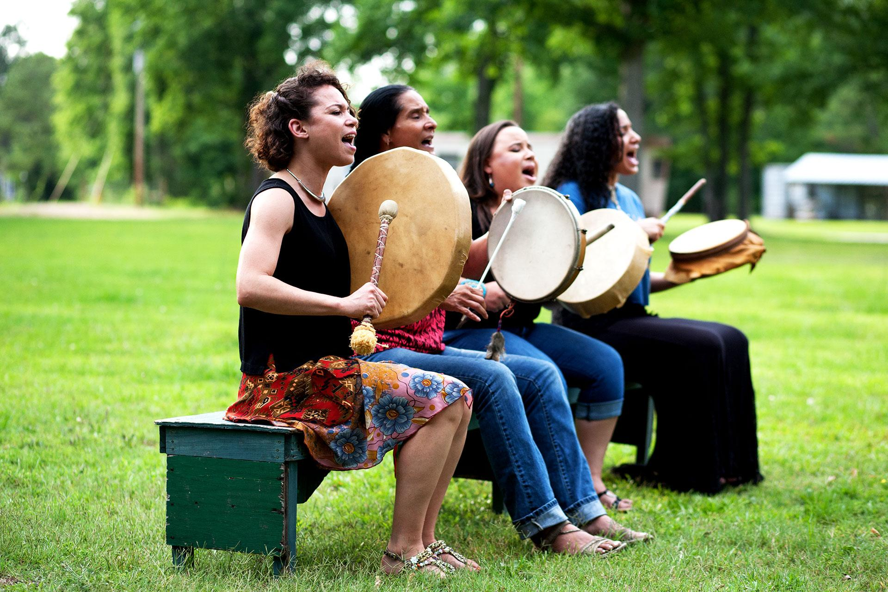
Lesson 2: Research and Planning
Students explore the Speak/Sing Native Database.
Choose a theme (genre, issue, cultural lens).
Draft festival outline: goals, audience, style, responsibilities.

Slide 9

Lesson 3: Storyboarding
Create a visual plan showing order of performances, MC segments, transitions, and closing.
Identify where and how narration will appear.

Slide 10

Lesson 4: Production
Gather footage from the database and follow Fair Use guidelines.
Write MC scripts, record narration, and begin editing.

Slide 11
Lesson 5: Peer Review
Use the Peer Review Guide to exchange feedback with another team.
Make adjustments to timing, theme consistency, editing, etc.

Slide 12

Lesson Six: Final Festival Submission
Upload completed festival for peer and public viewing.
Reflect on the process and the representation of Native voices in media.
What kind of feedback did you receive? What did the students learn? What would they do differently?

Slide 13
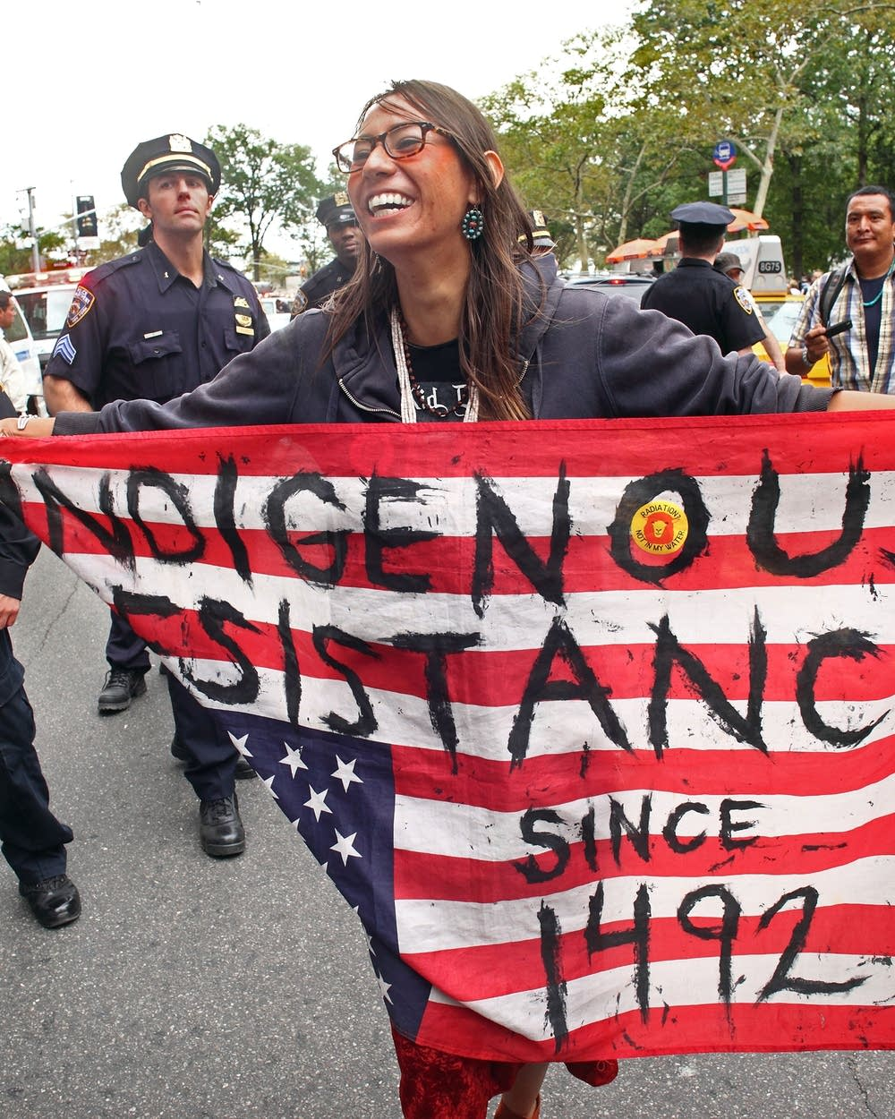
Links to Suggested Resources:
ODE Tribal History/Shared History
Jim Pepper Native Arts Festival
Speak/Sing Native Database
ODE Tribal Consultation Toolkit

Slide 14
Reflection and discussion
From Billie Holiday singing “Strange Fruit” to Woody Guthrie singing “This Land is Your Land” from Janelle Monae singing “Say Her Name” to Pete Seeger’s “We Shall Overcome” and “Green Day’s “American Idiot” - artists have often included political messages in their music.
What are your experiences with protest music?
What impact has protest music had on social movements?
Are there songs your students could bring to class that represent social movements they care about?
Can listening to Indigenous music give students more understanding towards Indigenous issues that they also care about? Climate justice for example?

